Slide 1
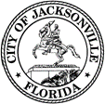
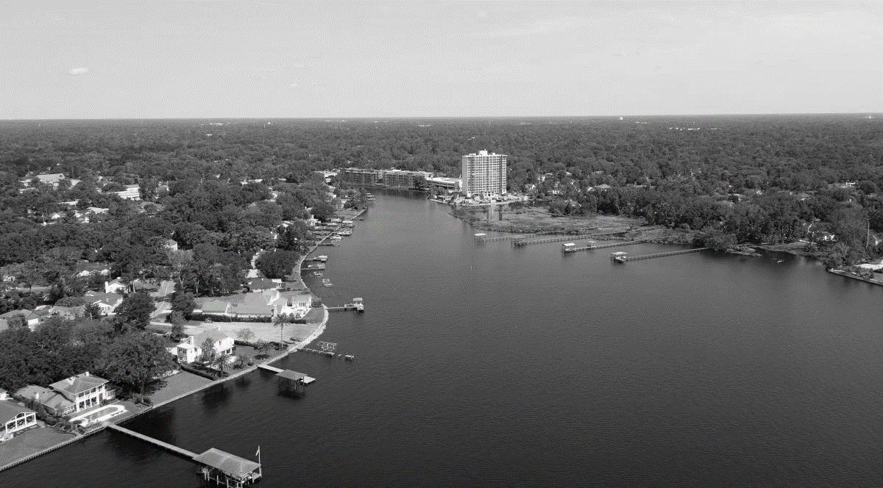
BIG FISHWEIR CREEK, DUVAL COUNTY, FL
AQUATIC ECOSYSTEM RESTORATION PROJECT
Presented By:
Jason Harrah
U.S. Army Corps of Engineers Jacksonville District
October 29, 2019
BUILDING STRONG
®
US ARMY CORPS OF ENGINEERS | Jacksonville District

Slide 2
BIG FISHWEIR CREEK, DUVAL COUNTY, FL overview
Project Sponsor: City of Jacksonville
Study Initiated: 2008
Authorizing Document: Big Fishweir Creek Final Integrated Project Report and Environmental Assessment, dated January 2012, approved by Division Commander for South Atlantic Division on 19 February 2013
Authorization for Construction: Water Resources Development Act (WRDA)1996
Project Partnership Agreement Executed: June 2018
Cost Share: 65% Federal, 35% Non-Federal
Total Estimated Cost: $6,539,700
September 13, 2019
BUILDING STRONG
®
US ARMY CORPS OF ENGINEERS | Jacksonville District

Slide 3
BIG FISHWEIR CREEK, DUVAL COUNTY, FL
Problems
Sediment covers native stream habitat
Loss of open water, wetlands, and aquatic habitats
Decline in essential fish habitat
Loss of manatee access corridors and food sources
Decrease in wading bird habitat
Water quality degraded
Opportunities
Replace lost wetland functions(wildlife habitat and marsh bio-diversity)
Enhance Essential Fish Habitat (improving degraded water quality)
Restore habitat for protected species (manatee, wood stork, and migratory birds)
Re-establish intertidal and sub-tidal benthic communities

Slide 4
BIG FISHWEIR CREEK, DUVAL COUNTY, FL project challenges
No dredging will occur underneath the Herschel Street Bridge due to concerns raised by FDOT (Area B)
  - This area might be dredged under a future contract once FDOT replaces the bridge (several factors would have to be evaluated).
Concerns with proposed marsh island creation (public, sponsor, design, constructability, etc.)
- The island feature will not be constructed
- All dredge material will be hauled off site to an approved landfill facility
Constructability Discussions
  - Disposal plan for dredged material (i.e. location to offload material for drying and future disposal) must be identified by sponsor
  Staging/Access locations for prime contractor must be identified by sponsor
PRB Sep 2018
PRB July 2019

Slide 5
Design
Features
PRB Sep 2018
PRB July 2019
Estimated Total Dredging Volume: 28k cy

Slide 6
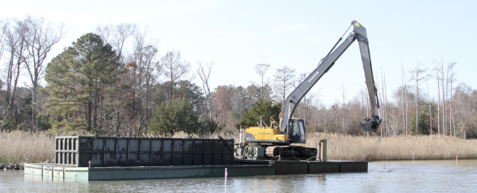
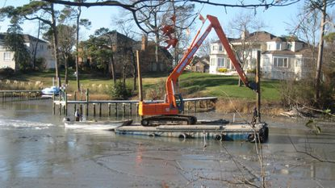
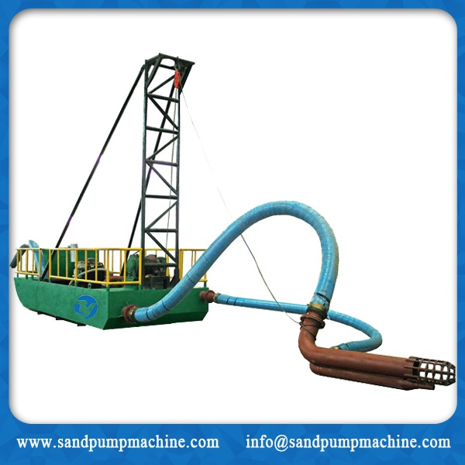
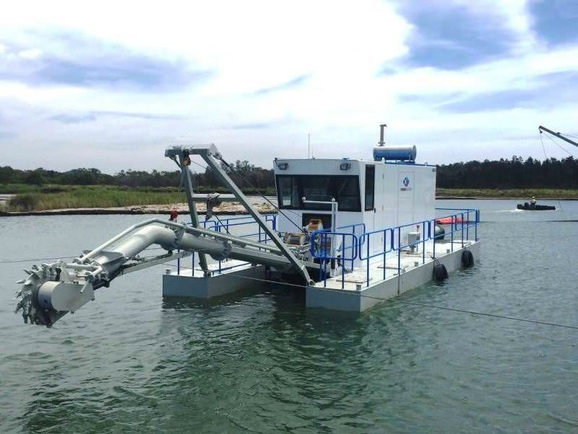
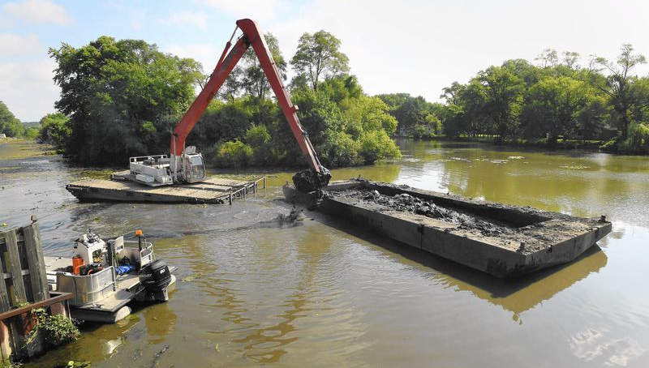
BIG FISHWEIR CREEK, DUVAL COUNTY, FL
Construction examples
September 13, 2019
BUILDING STRONG
®
US ARMY CORPS OF ENGINEERS | Jacksonville District

Slide 7
BIG FISHWEIR CREEK, DUVAL COUNTY, FL schedule
September 2019 - March 2020
Environmental Testing of Creek
April 2020 - October 2020
Plans/Specifications Design Reviews (4 different review levels)
November 2020 – January 2021
Contract Advertised
State Water Quality Permit w/FDEP
Obtain staging/access, material laydown area from City of Jacksonville
Geo-technical Core Samples
Lab Testing and Report
Bid Opening (Low Price/Technically Acceptable)
March 2021
Construction Initiated (approximately 8-12 months to complete)
Initiation of Draft Plans/Specifications
Award to Contractor
PRB Sep 2018
PRB July 2019

Slide 8
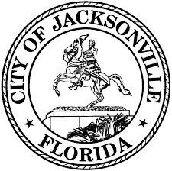
Questions?

